Slide 1
Accelerometer sleep state prediction
Project progress presentation

Slide 2
Why accelerometer sleep state detection?
Easy sleep logging
Diagnostics
Research
Accurate sleep logging is difficult especially among young children.
Parents and doctors can get vital information about the child’s health.
Cheap sleep logging enables large sleep studies.

Slide 3
What is our user demographic?
Child
Parents/doctors
Researchers
Wears the data collecting wrist band.
Consumers of the sleep state data and pays for the product.
Needs the product in bulk for the sleep study participants

Slide 4
Project Scheduling
Study
Learn
Explore
Evaluate
Present
I want to
S
L
E
E
P
Study other approaches and solutions.
Learn the data and apply feature augmentation/selection.
Explore different models and approaches
Evaluate and fine tune, test in real world data (optional with APP)
Present the results in a report

Slide 5
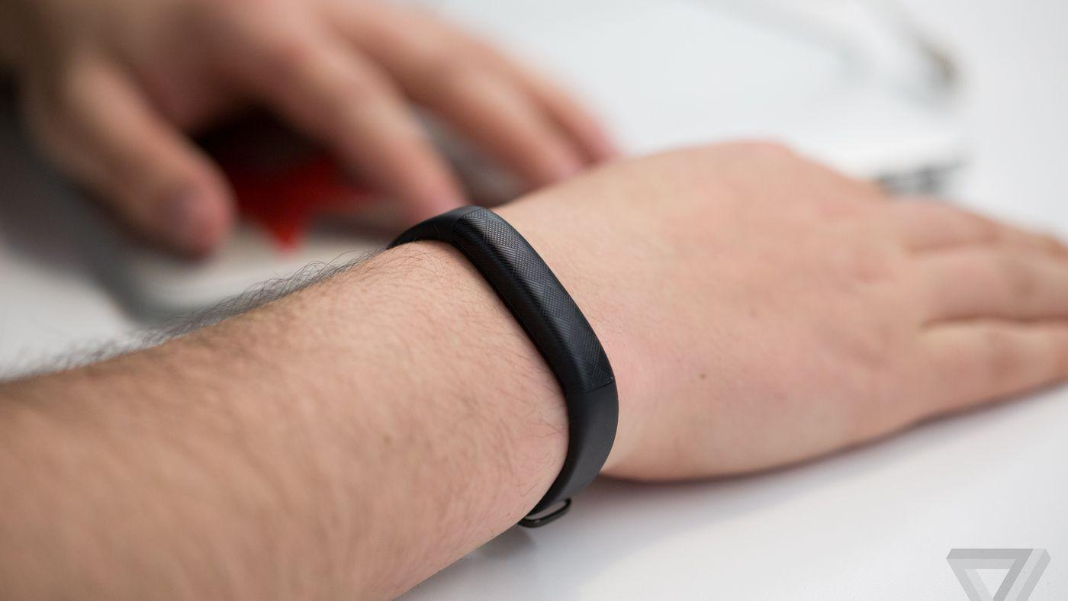
Optimal form factor:
Wristband
Cheap
comfortable
discrete
Energy efficient
Product needs to be developed

Slide 6
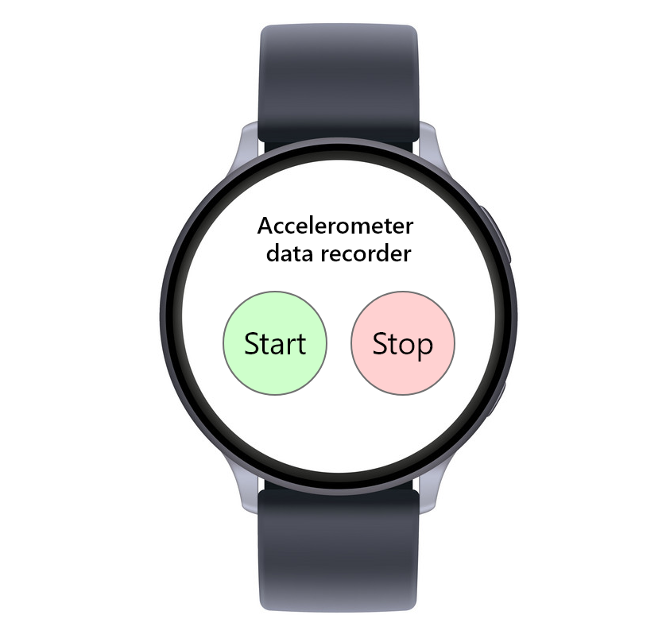
Our implementation
Samsung galaxy watch application for recording accelerometer data.
Fetch accelerometer data through Tizen networking API
Flask web application for processing data and presenting results

Slide 7
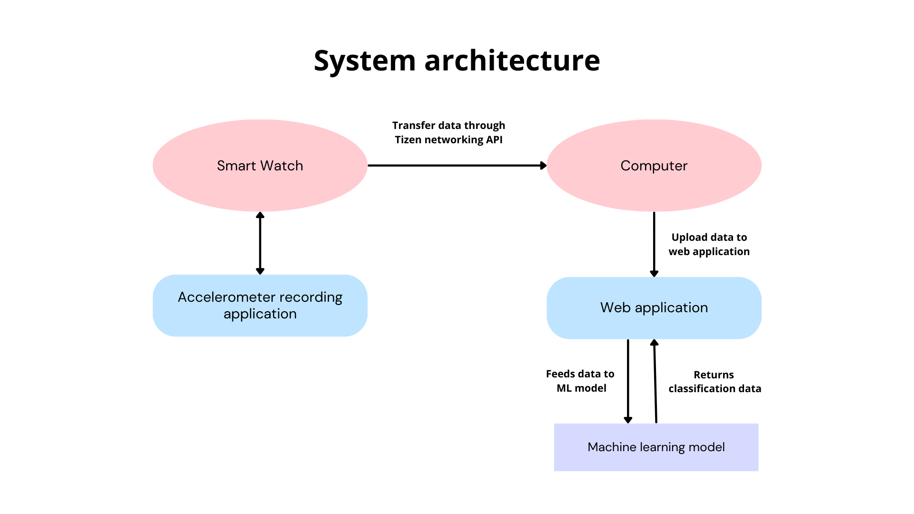
You can replace the image on the screen with your own work. Just right-click on it and select “Replace image”

Slide 8
127.946.340
Number of rows in the dataset

Slide 9


Data Files
train_series.parquet
train_events.csv
500 days accelerometer recording at a 5 seconds interval
Wake and onset events

Slide 10
Feature Engineering
LIDS
TIME FEATURES
SLEEP SIGNALS
DIFFERENCE FEATURES
ROLLING FEATURES
ENTROPY
STEPS TO PREV/NEXT PEAK
MUTUAL INFORMATION
CORRELATION
RANDOM FOREST IMPORTANCE

Slide 11
Architecture
Coarse
Fine
Post
10 min/window
1 min/window
10 sec/window
Gets a rough window of where the event happens
Applies a modified Image segmentation model for time series
PointRend or sharpening filters

Slide 12
Thanks!
Lukas Johansson
Aurelio Negri

